Slide 1


Work-Study Counter
Work-Study Counter
Gandy Mendieta - Juan Torres - Daniel Rodriguez

Slide 2


Slide 3
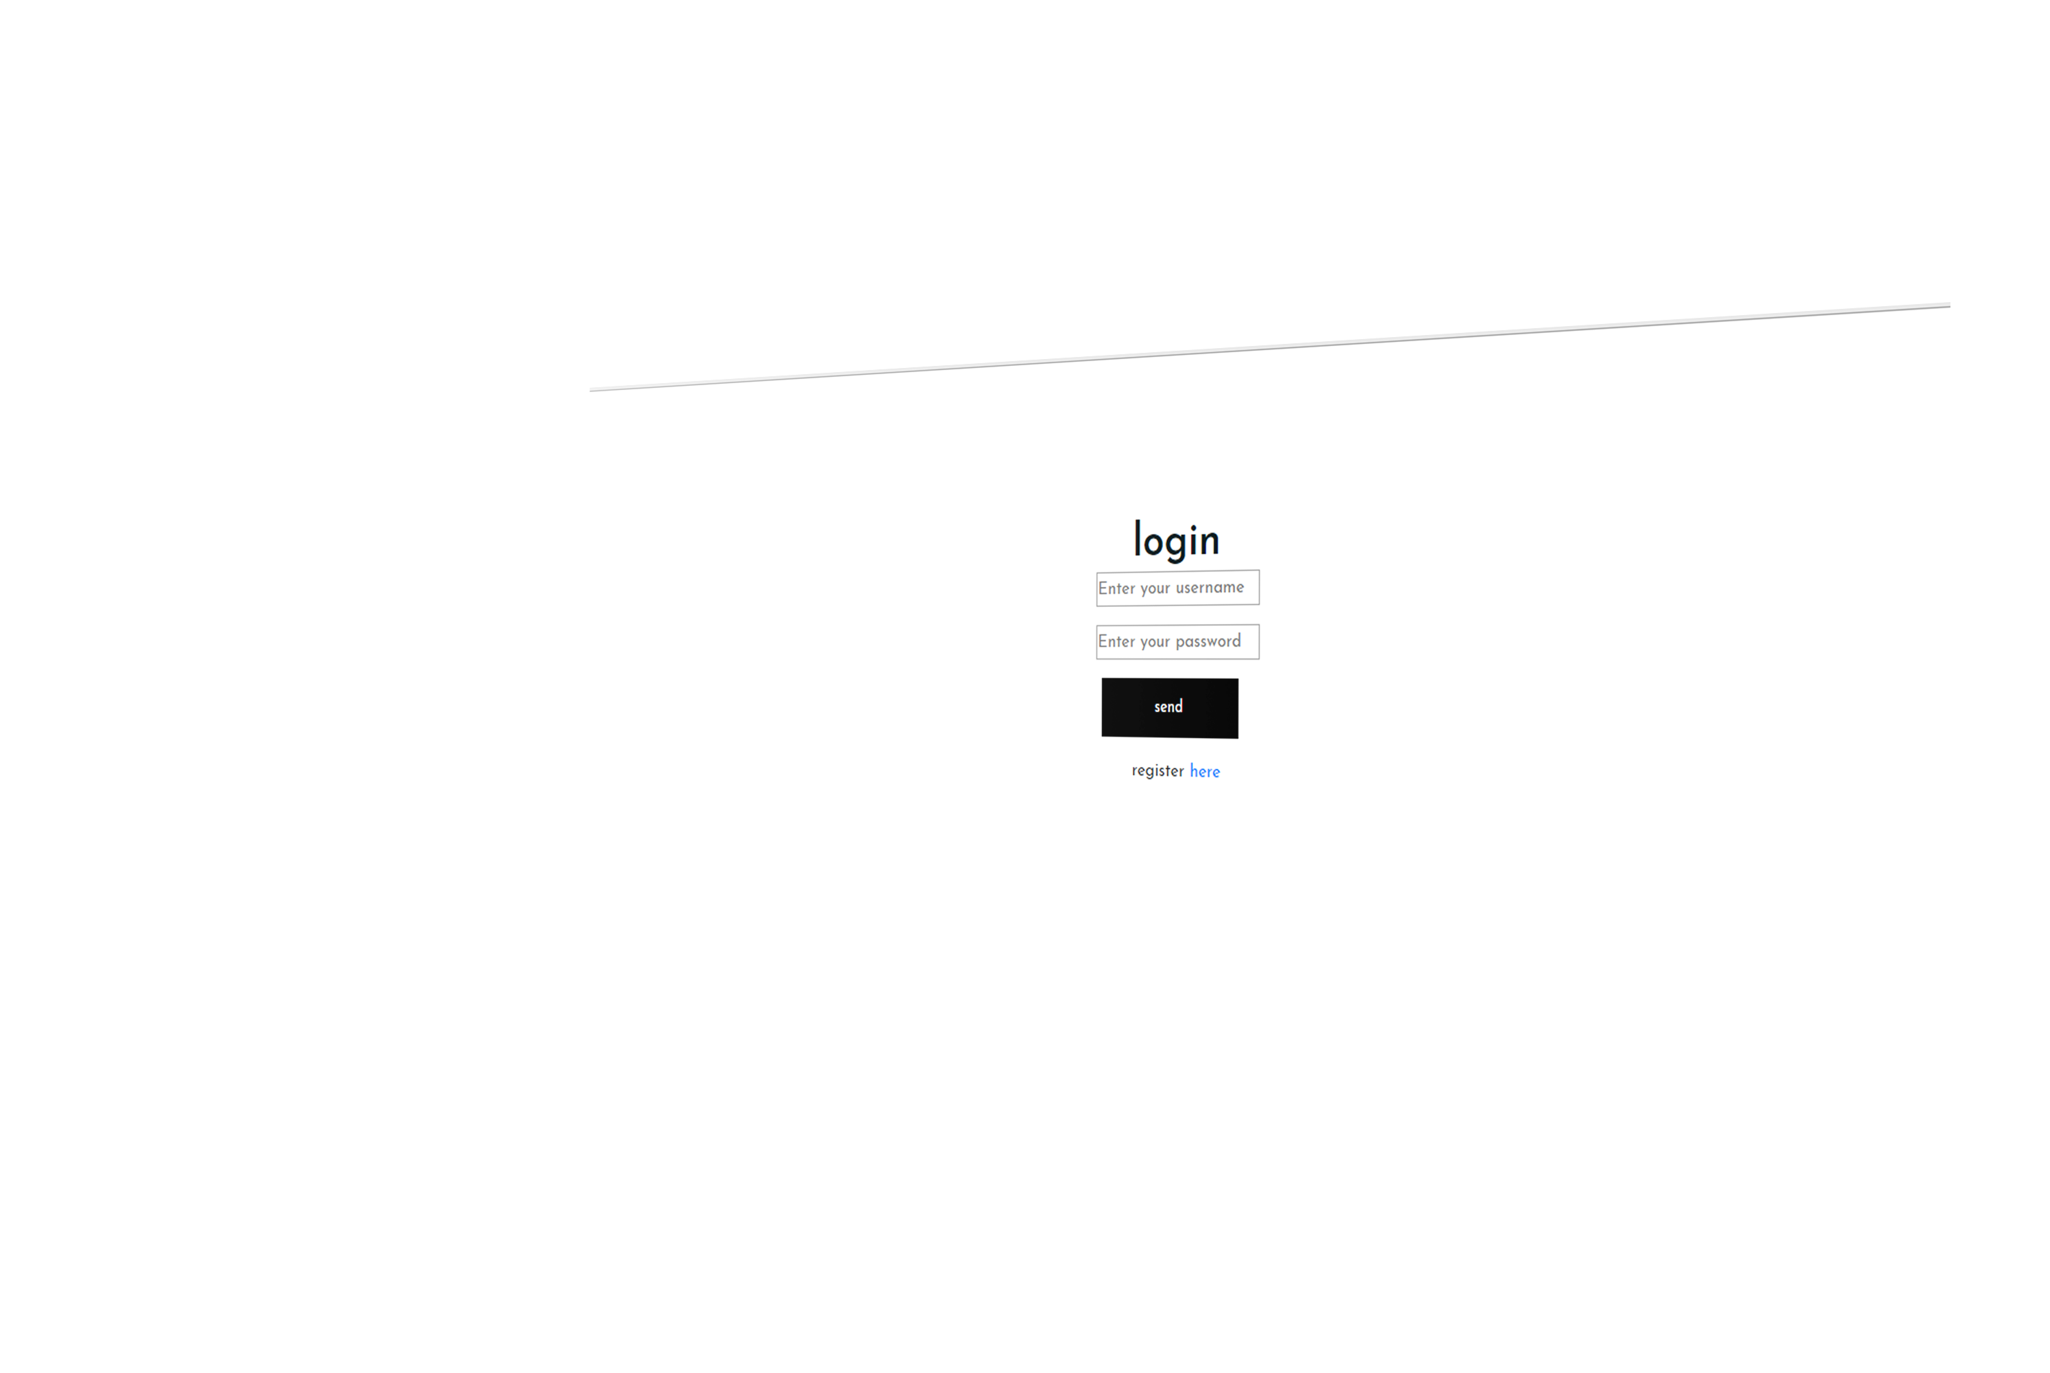



Doing an efficient work

Slide 4
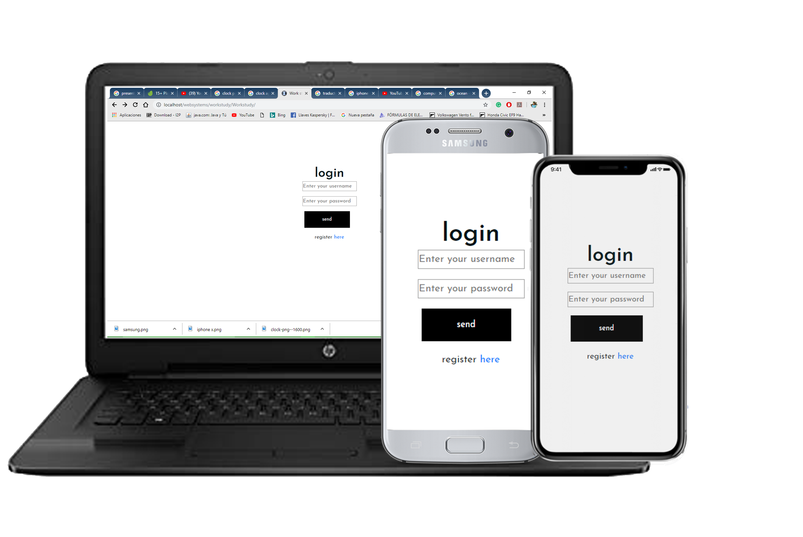
Multiplatform
Available in:
Android
Apple
Windows

Slide 5
Benefits of using this WSC
Better control- Less time spent
- Easy Access – Easy to Use- Minimalist interface

Slide 6
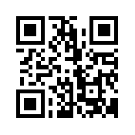
Security
Students have allowed to log in
Just at work. Scanning the QR of
the office they will have access.

Slide 7
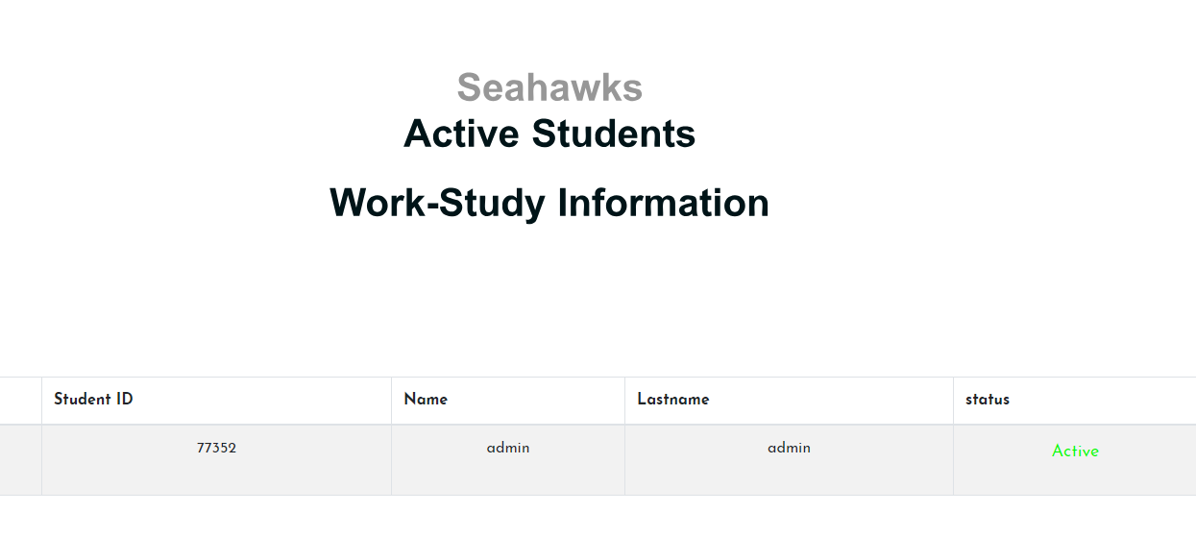
Windows to see active students

Slide 8
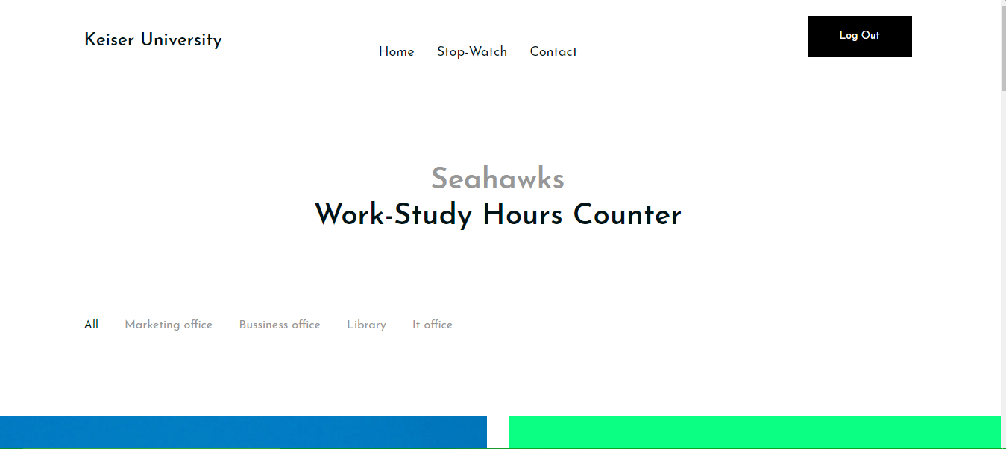
Newsletter
Where students can look for a Job vacancy

